Slide 1
N P K M A P P I N G
Debabrata Mitra
Non-Profit Business

Slide 2





1
Unveiling The Thoughts
2
S O LU T I O N
& I D EA
3
H O W IT
W O R K S
4
W O R K F LOW
M A I N
A G R I C U LT U R A L
P R O B L E M S I N I N D I A

Slide 3

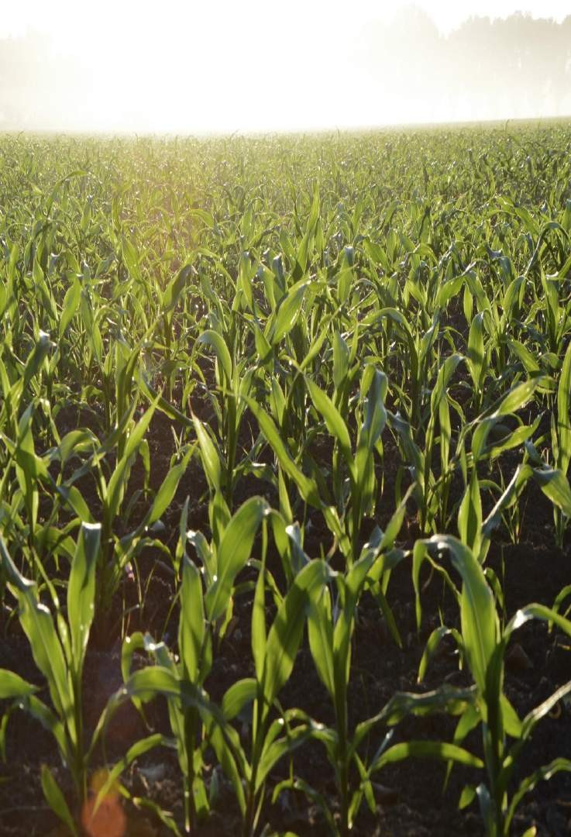
Technology is changing farming in India, but there are challenges affecting productivity and sustainability:
1. Small Farms: Many farmers have small plots, making farming inefficient. This makes it hard for them to use modern methods and technologies, leading to lower productivity.
2. Old Farming Methods: A lot of Indian farmers still use traditional methods due to limited information and resistance to change. This lack of awareness hampers the use of better farming practices.
1. Main Agricultural
Problems
3. Soil Issues: Wrong land use, too many chemicals, and poor soil conservation harm the soil. This lowers fertility, increases vulnerability to pests and diseases, and reduces productivity.
4. Tech and Research Access: Farmers struggle to access agricultural services, modern technologies, and scientific research. They need better knowledge sharing, training, and affordable technology tailored to their needs.

Slide 4

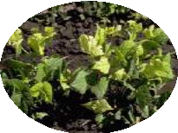
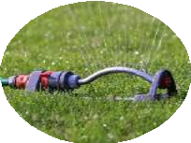
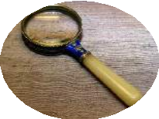
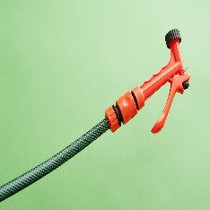
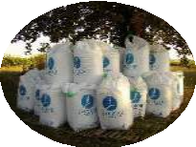
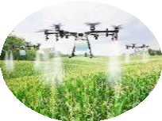
Solutions
Firstly, it is crucial to understand the levels of nitrogen (N), phosphorus (P), and potassium (K) in the field. Secondly, accurate knowledge of nutrient content enables farmers to determine the appropriate type and intensity of fertilizer required for optimal crop growth. Finally, this information enhances efficiency in agricultural practices, ensuring that crop yields are maximized while minimizing soil and water pollution.
Ideology
Detecting The Nutrients Level Of The Specific Field Location (GPS Co- ordinate)
Smart Spraying system will have its GPS & and will connect to the specific app by WIFI
Analyzing The Data & Mapping Nutrient Level In Google Map
Smart Spraying system to Spray the specific fertilizer in a specific amount in a particular position.
Suggesting The Fertilizer Type, Intensity & Next Planted Crops through App
This system can also be connected to the Drone Spraying and mission planning application. ( E.G- Qgc)

Slide 5

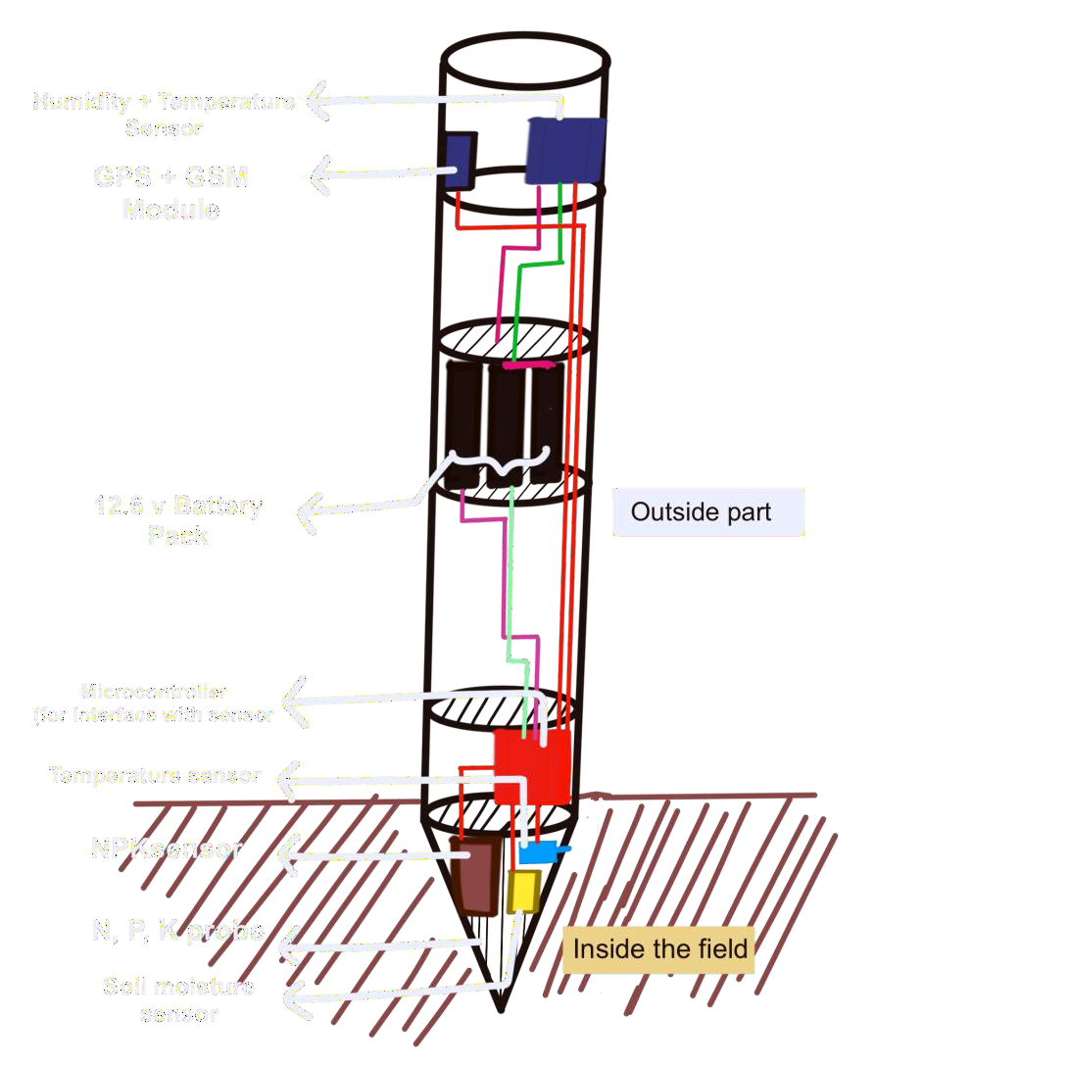




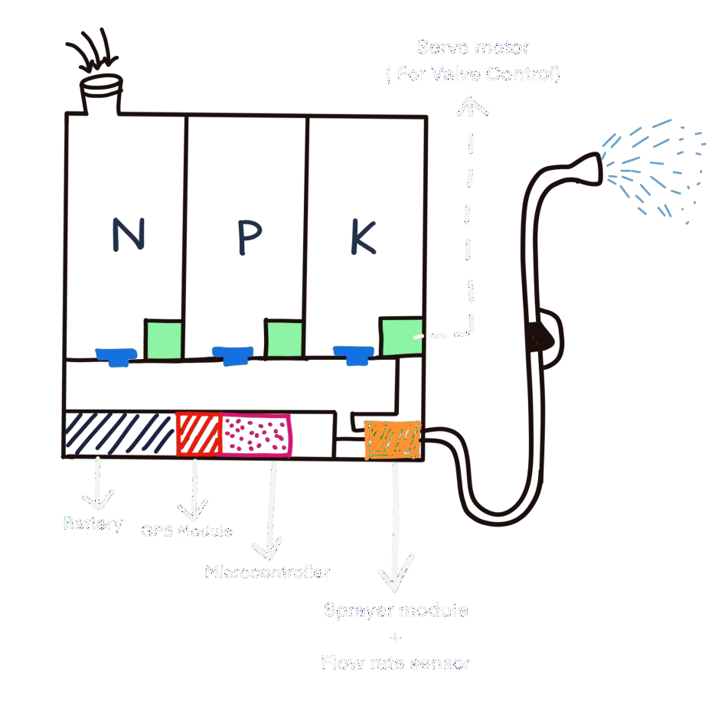






Cloud
[ NPK Detector ]
[ Smart Sprayer ]
[ Drone Sprayer ]

Slide 6


GPS+GSM
[module transmits the data through the 4G internet]
CLOUD
STORE [the data and pass to the app]
SENSOR
detects the parameter value
ESP32
Microcontroller interface the sensor value
Servo valve
ESP32 [microcontroller for interface flow-rate sensor, GPS co-ordinate, control motor driver, and servo valve]
APP
MOTOR DRIVER
[for controlling the fertilizer selection .]
MOTOR
[for spraying.]
Drone spraying system
Flow rate sensor [detect the flow rates from motor
Nozzle and feedback
to the esp32.]
GPS
[find the current location of the sprayer and send it to the app by esp32.]

Slide 7


